Slide 1


Consumer Review Analysis on Clothing Products
Analyzing Customer Sentiments in Fashion Retail through Machine Learning

Slide 2
Introduction: Decoding Customer Voices
In modern retail, consumer reviews are pivotal.
They guide purchasing decisions by reflecting product quality, durability, and design.
Our project harnesses these insights using machine learning.
We specifically explored Support Vector Machines (SVM) and K-Nearest Neighbors (KNN).
This work offers dual benefits:
Enhances sentiment analysis in fashion.
We utilized a Kaggle dataset comprising review titles, full texts, ratings, and clothing categories. Our goal: develop a supervised classification model predicting customer ratings.
Demonstrates ML's power in understanding preferences and improving product offerings.

Slide 3
Literature Survey: Bridging the Gap
Sentiment Analysis Foundations
Established ML Performance
Our Novel Approach
Most research focuses solely on review text. We address this by integrating both text and product features (e.g., material, durability) for enhanced accuracy. This provides a holistic view for fashion retailers.
Sentiment analysis, or opinion mining, classifies reviews as positive, neutral, or negative. It's a cornerstone in understanding consumer feedback.
Previous studies show SVM excels with high-dimensional text data, while KNN is effective for similarity-based review analysis.

Slide 4
Dataset & Exploratory Analysis
We gathered approximately 45,000 consumer reviews of clothing products, each detailing review text, a 1-5 rating, and clothing category.
Initial correlation analysis revealed low correlation between product attributes (material, color, durability) and ratings. Thus, we streamlined our focus to review text and customer ratings.
Ratings were simplified into three categories:
Positive: Rating > 3
Neutral: Rating = 3
Negative: Rating < 2

Slide 5

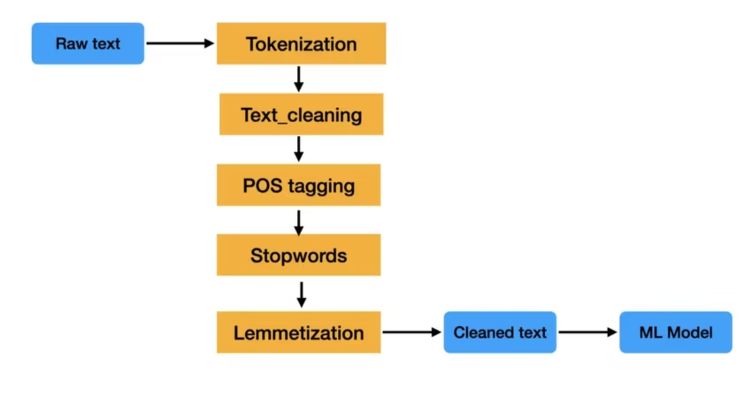
Data Preprocessing: From Text to Numbers
Before model training, rigorous preprocessing was essential:
Text transformed to lowercase; punctuation, numbers, and unnecessary symbols removed.
Sentences tokenized into individual words; common stopwords excluded, except crucial context-modifying words like 'not'.
Lemmatization applied to convert words to their root form (e.g., 'dresses' to 'dress').
Cleaned text converted into numerical format using TF-IDF vectorization, assigning weights based on word importance.
These steps transformed unstructured text into structured, numerical data ready for machine learning models.

Slide 6
Model Implementation: SVM vs. KNN
Support Vector Machine (SVM)
K-Nearest Neighbors (KNN)
Utilized a linear kernel.
Tested with various 'K' values; K=5 yielded optimal results.
Achieved strong performance metrics:
Accuracy: ~82.6%
Demonstrated lower overall accuracy:
F1 Score: 81.6%
Accuracy: ~74.3%
Precision: 81.1%
F1 Score: 66.7%
Precision: 66.0%
Performed exceptionally well on positive reviews, though performance for neutral and negative classes was slightly lower due to data imbalance.
Overall, SVM significantly outperformed KNN across all metrics, proving more suitable for text-based sentiment analysis in this context.

Slide 7
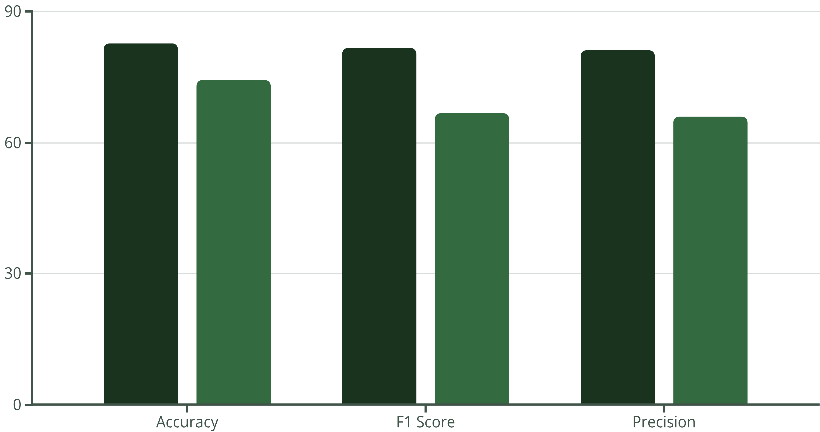
Evaluation & Comparison: A Clear Winner
Our evaluation clearly shows SVM's superior performance, especially in handling high-dimensional, sparse data like TF-IDF vectors.
While positive reviews were classified with high precision, the smaller sample size for neutral and negative reviews presented a classification challenge. Addressing this imbalance is a key area for future improvement.
SVM
KNN

Slide 8
Real-World Predictions
"I like this dress."
— Customer Review Example
SVM Prediction
KNN Prediction
Positive
Positive
This example demonstrates our models' capability to provide meaningful predictions on new, unseen data, proving their real-world applicability.

Slide 9

Conclusion
Key Findings
SVM (82%+ accuracy): Highly suitable for sentiment analysis of clothing reviews.
KNN: Less effective due to high-dimensional feature space.
ML provides valuable insights for retailers to improve products and enhance customer satisfaction.
Our project underlines machine learning's power in understanding consumer behavior, contributing to better decision-making in the fashion retail industry.

